Slide 1
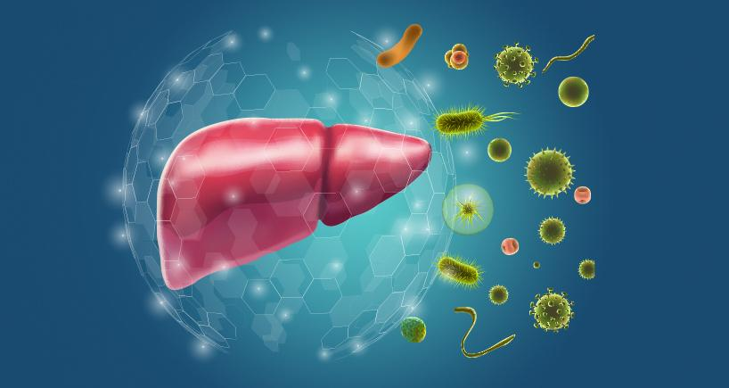
Autoimmune hepatitis
By :Mostafa Elateek Fouad

Slide 2
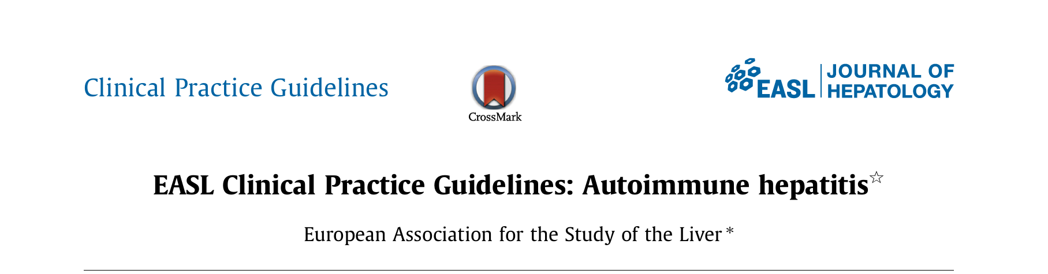
The data included in this presentation are based on EASL 2025 guidelines

Slide 3
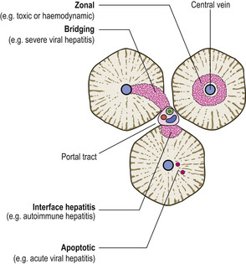
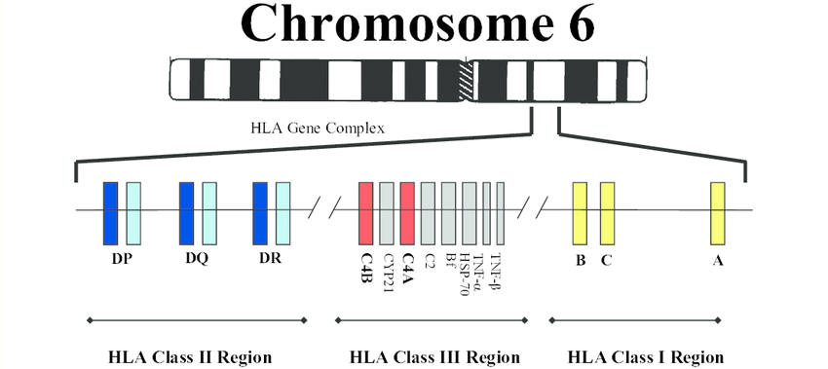
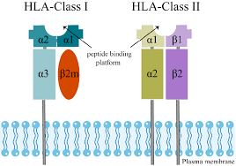
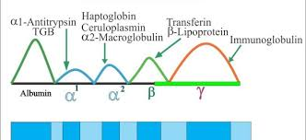
Definition:
a non-resolving
hypergammaglobulinemia
Circulating autoantibodies
(HLA) DR3 or DR4
interface hepatitis on liver histology

Slide 4

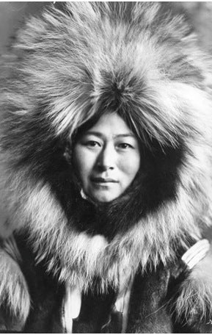

Epidemiolody :
AIH is considered relatively rare, as its prevalence ranges from 16 to 18 cases per 100,000 inhabitants in Europe
AIH prevalence and clinical expression seem to vary according to ethnicity
Alaskan natives: acute icteric
African American: cirrhosis
Mexican Mestizos: cirrhosis
Hispanic origin : cirrhosis and cholestatis

Slide 5

Epidemiology:
Any age (with peaks around puberty and between 4th and 6th decade although a significant proportion of patients are even older (above 65 years of age)
• Both sexes (♀: ♂ 3:1)
• All ethnic groups

Slide 6
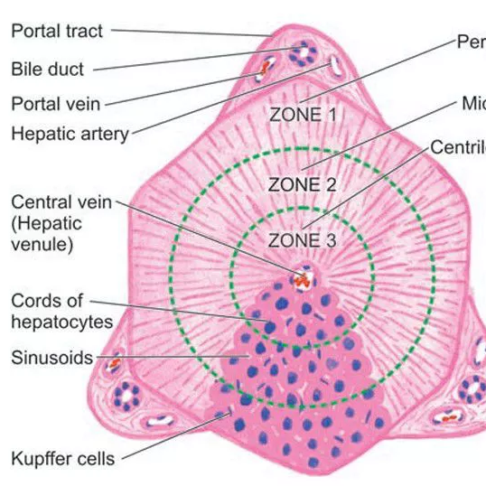
Clinical presentation :
Broad range from asymptomatic to acute/severe or even fulminant.
two thirds of patients is characterized by an insidious onset either without any apparent symptom.
Regarding acute presentation there are two clinical entities.
the acute exacerbation of chronic AIH.
the true acute AIH without histological findings of chronic liver disease.
(centrilobular zone 3 necrosis (central perivenulitis) usually present in patients with acute presentation)
autoantibodies can be absent.
One third of patients at diagnosis have already developed cirrhosis irrespective of the presence of symptoms

Slide 7
Classification:
AIH-1:
the more frequent type of AIH
accounts almost for 90% of AIH cases
any age at onset
rare failure of treatment
variable relapse rates after drug withdrawal
AIH-2:
accounts for up to 10% of AIH cases
onset usually in childhood and young adulthood
commonly acute and advanced
frequent failure of treatment
frequent relapse rates after drug withdrawal

Slide 8
AIH-3:
SLA/LP positive
very similar to AIH-1
Possibly more severe
Differences between AIH-1 and AIH-3 seemed less pronounced than between AIH-1 and AIH-2, but some authors postulated more severe disease and the need for lifelong immunosuppression in most if not all AIH-3 patients.

Slide 9
Let's go to the recommendations

Slide 10
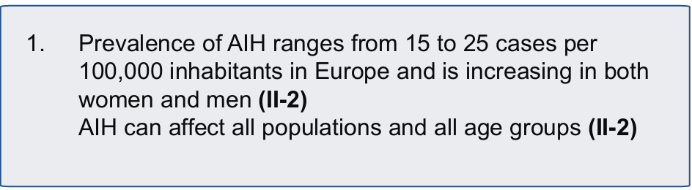


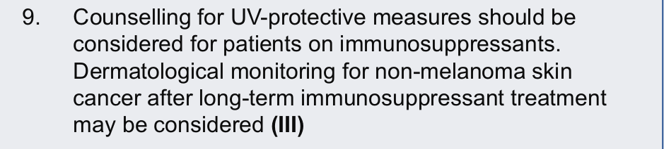

Slide 11
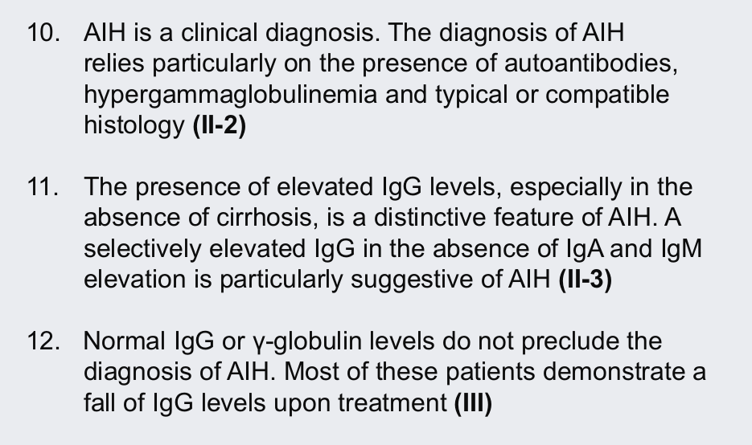

Slide 12
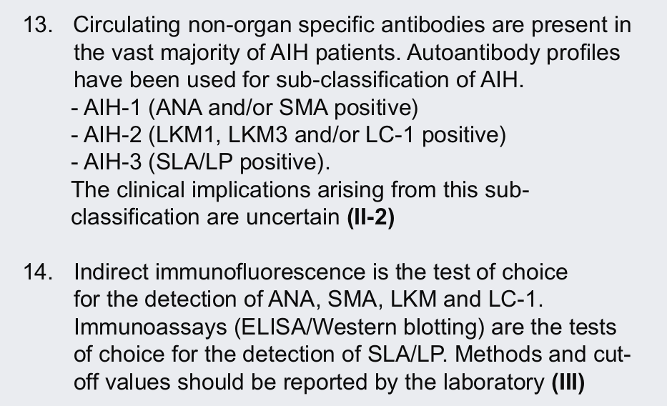

Slide 13
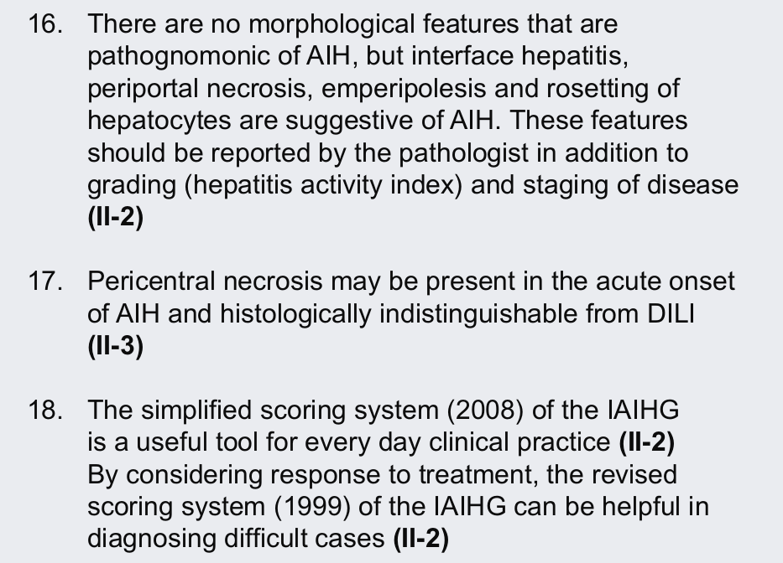

Slide 14
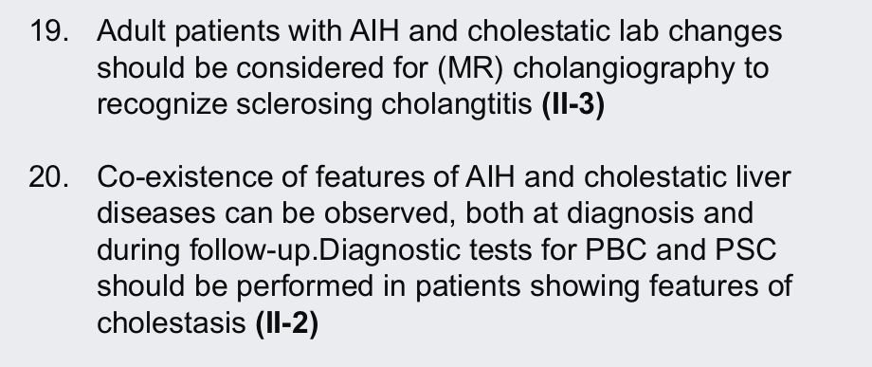

Slide 15
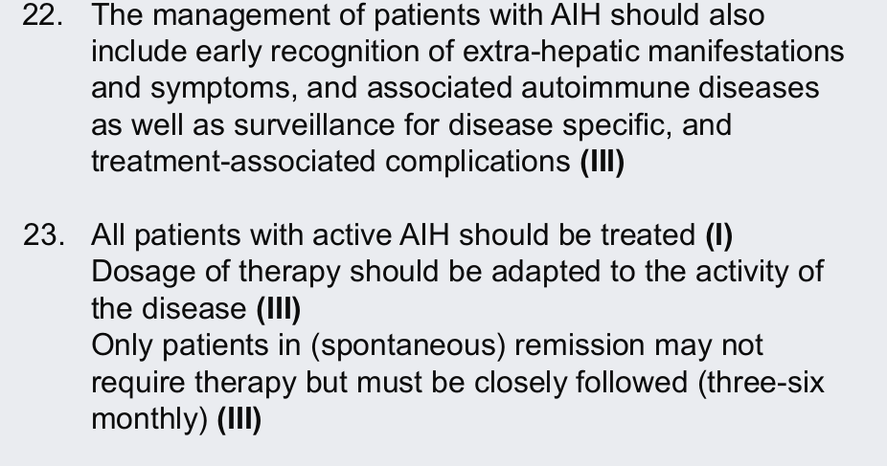

Slide 16
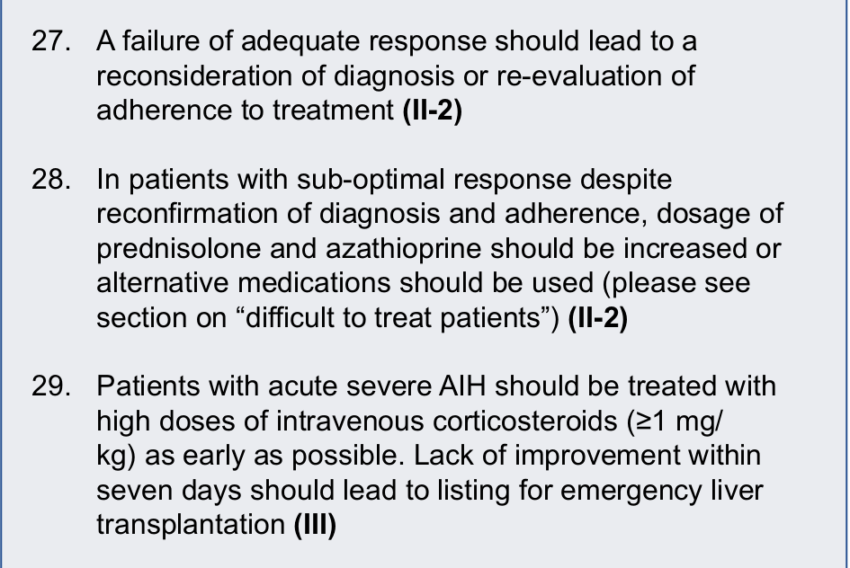

Slide 17
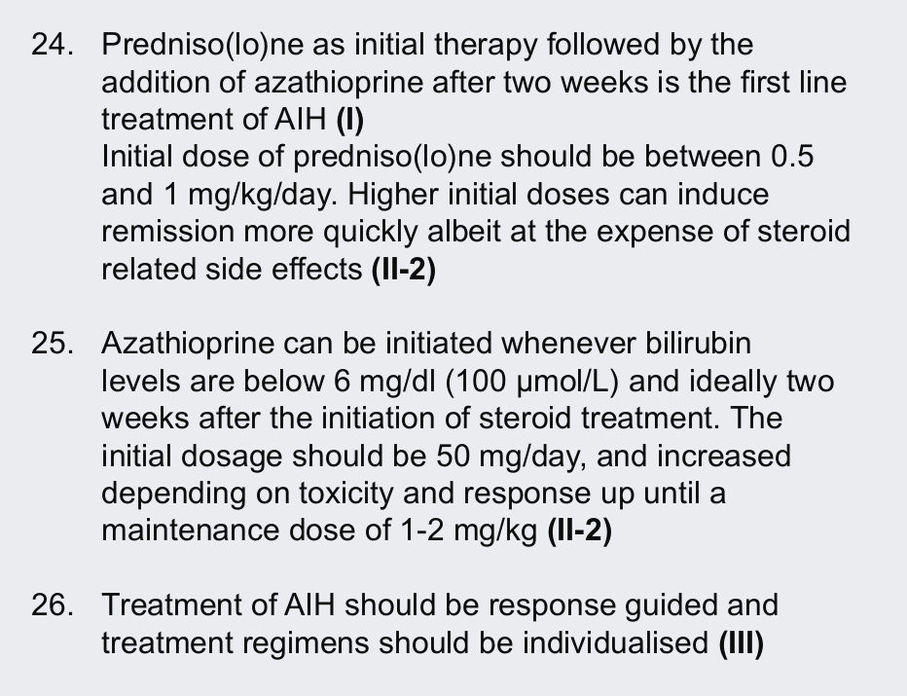

Slide 18
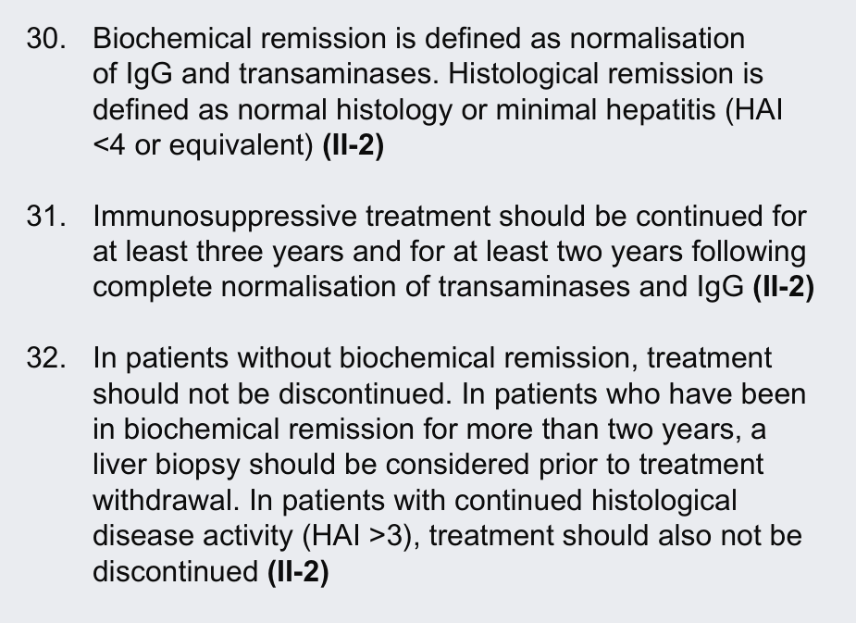

Slide 19
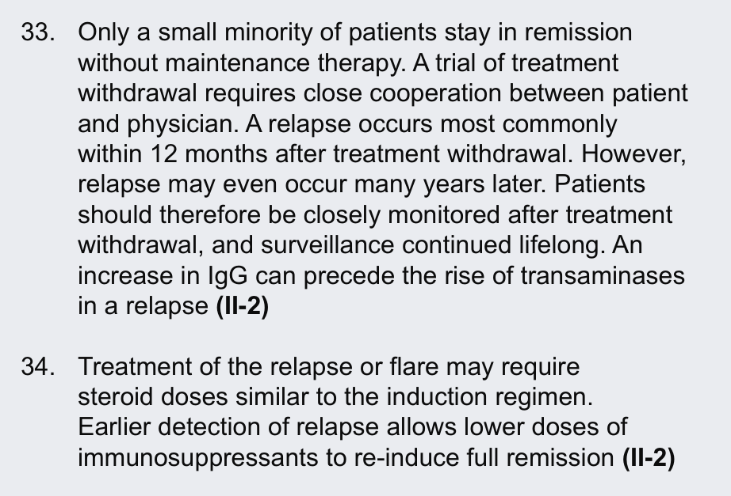

Slide 20
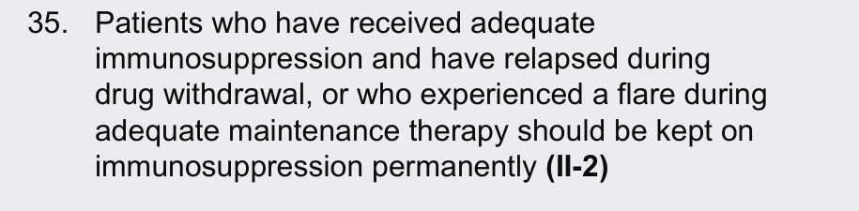
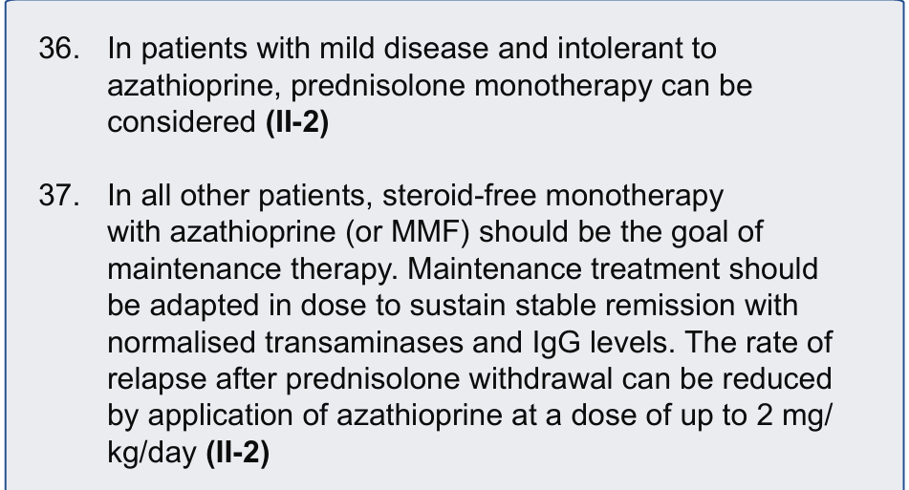

Slide 21
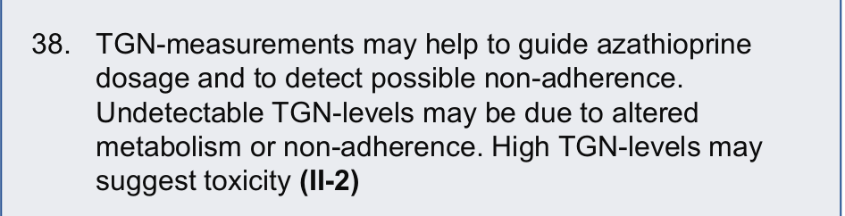
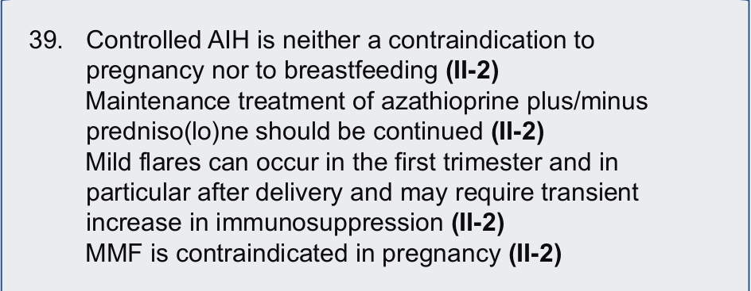

Slide 22
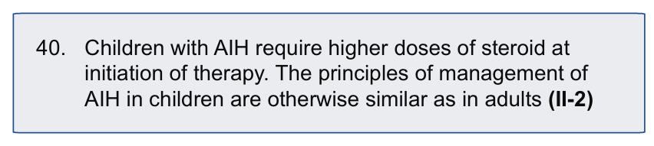
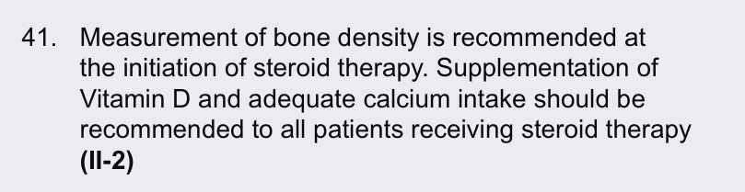

Slide 23
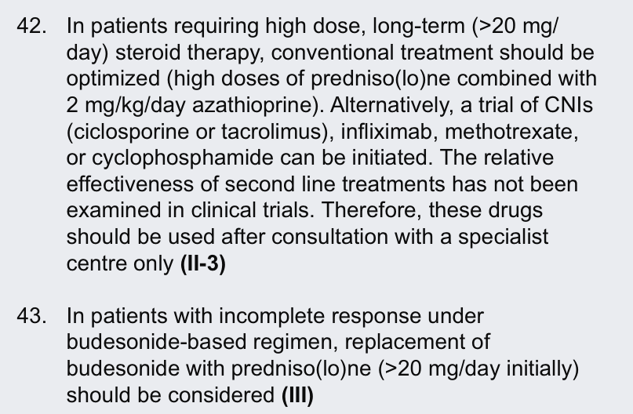

Slide 24
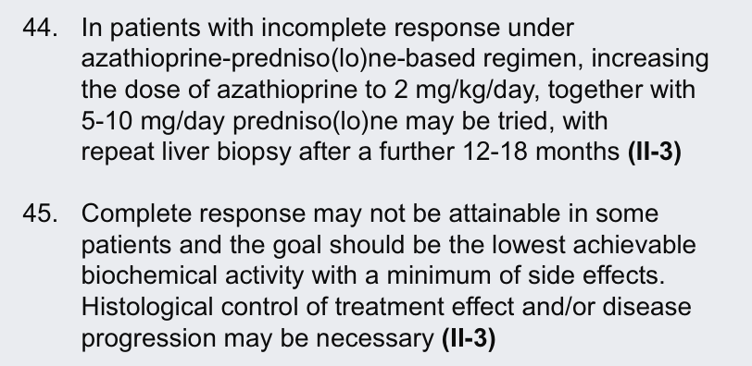

Slide 25
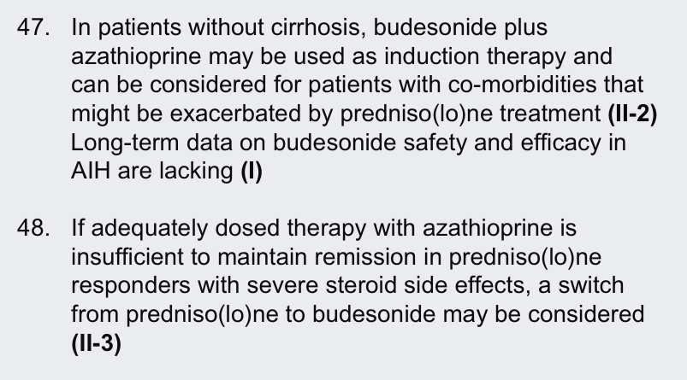

Slide 26
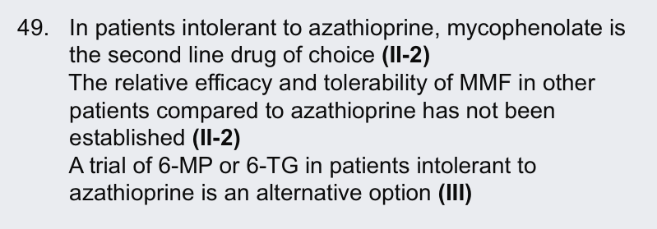
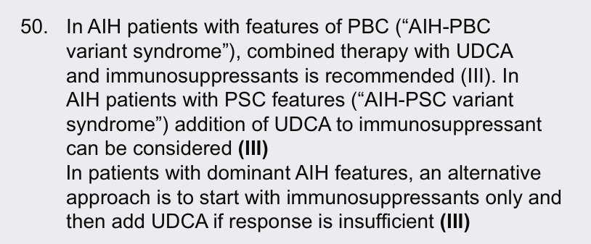

Slide 27
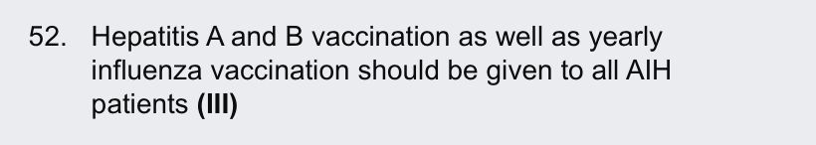

Slide 28
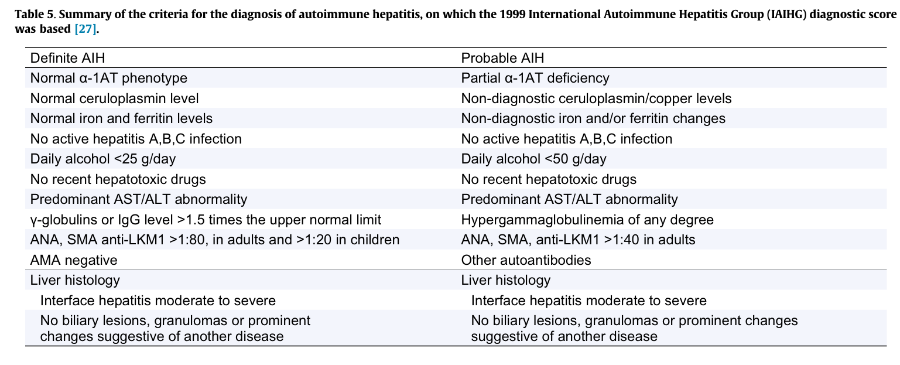

Slide 29
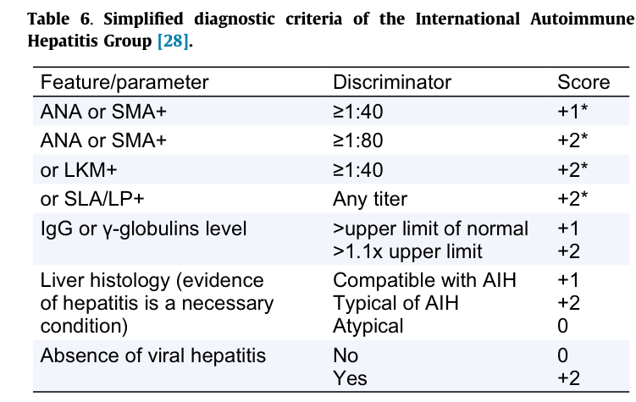

Slide 30
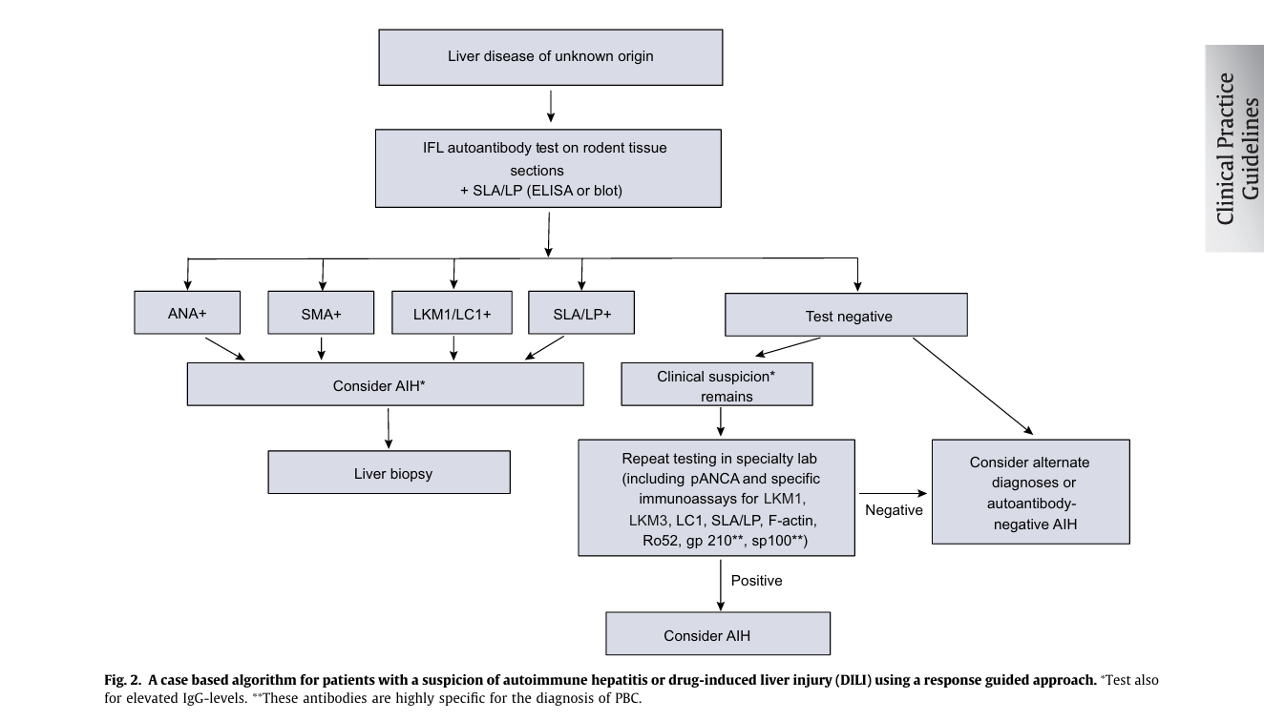

Slide 31
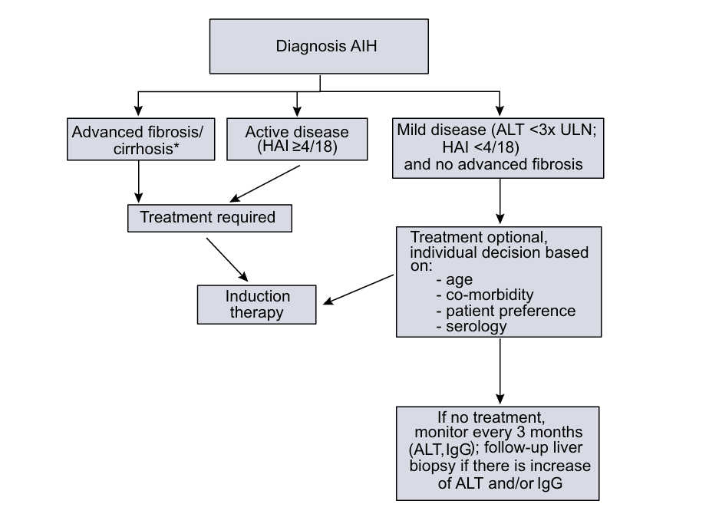

Slide 32
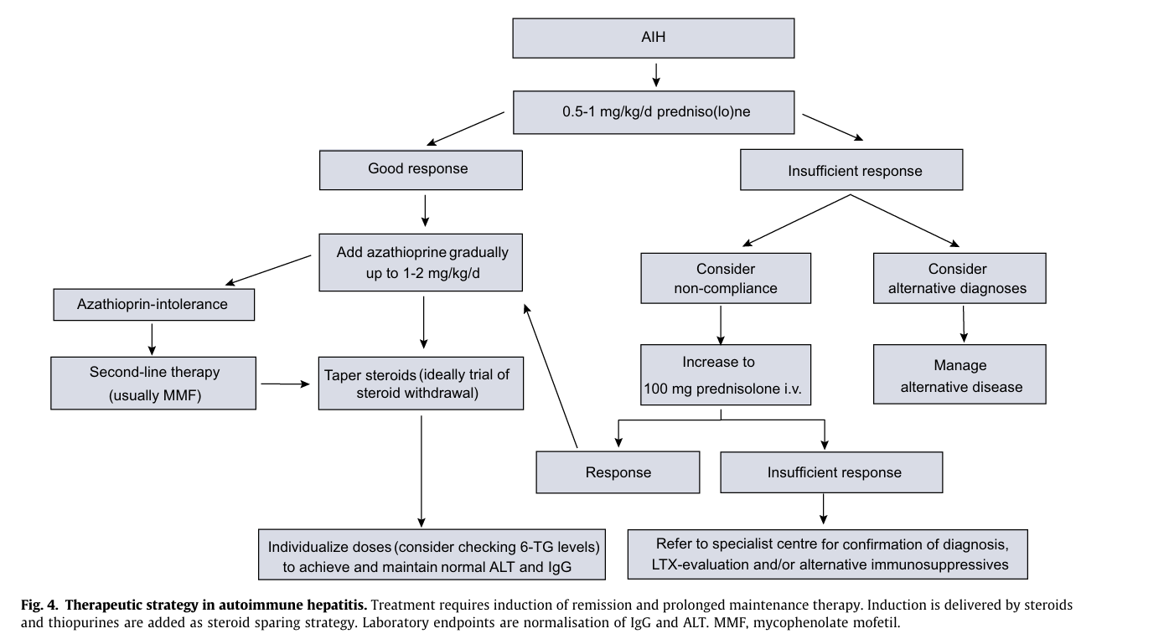

Slide 33
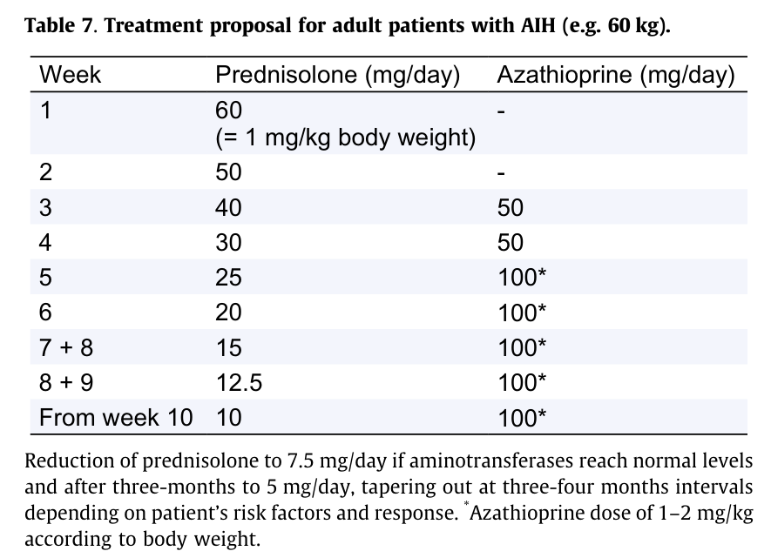

Slide 34
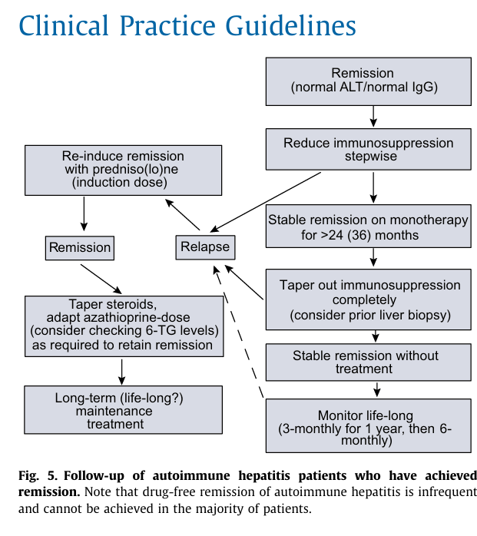

Slide 35


Slide 36


